Slide 1

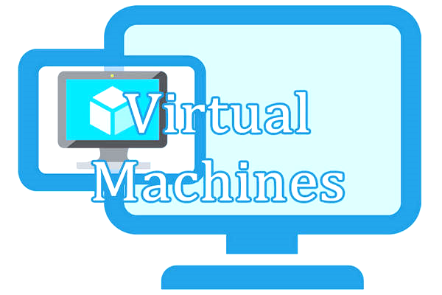
KING KHALID UNIVERSITY COLLEGE OF COMPUTER SCIENCE
Parallel

Slide 2
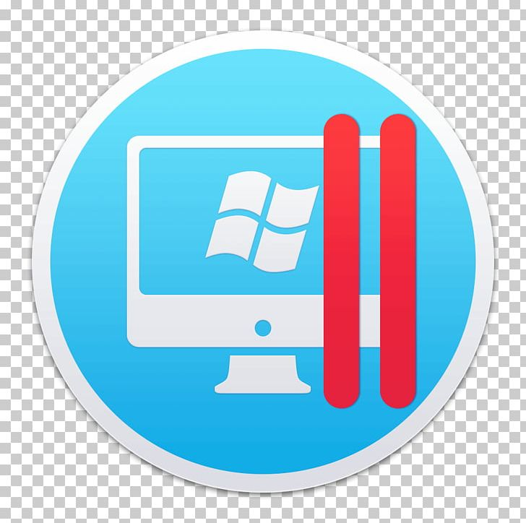
INTRODUCTION
Parallel processing, the method of having many small tasks solve one large problem, has emerged as a key enabling technology in modern computing.
The past several years have witnessed an ever-increasing acceptance and adoption of parallel processing, both for high-performance scientific computing and for more "general-purpose" applications, was a result of the demand for higher performance, lower cost, and sustained productivity.
The acceptance has been facilitated by two major developments:
massively parallel processors (MPPs)
Distributed computing

Slide 3
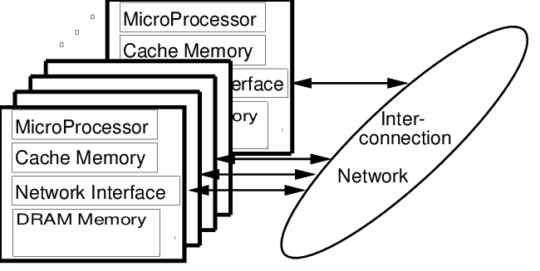

massively parallel processors
MPPs are now the most powerful computers in the world. These machines combine a few hundred to a few thousand CPUs in a single large cabinet connected to hundreds of gigabytes of memory.
MPPs offer enormous computational power and are used to solve computational Grand Challenge problems such as global climate modeling and drug design.

Slide 4
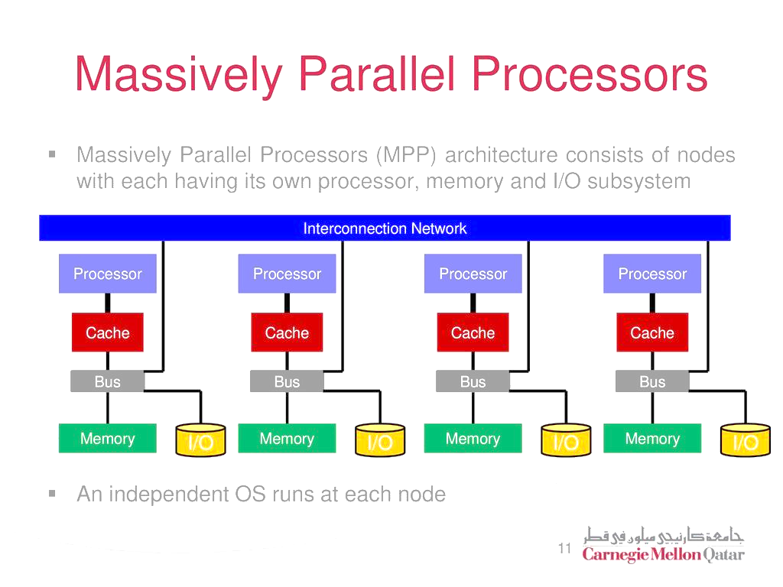

Slide 5
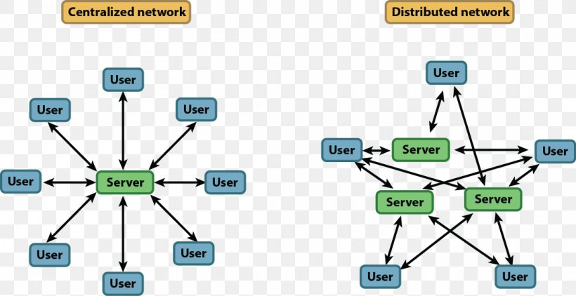
Distributed computing
Distributed computing is a process whereby a set of computers connected by a network are used collectively to solve a single large problem.
In some cases, several MPPs have been combined using distributed computing to produce unequaled computational power.

Slide 6
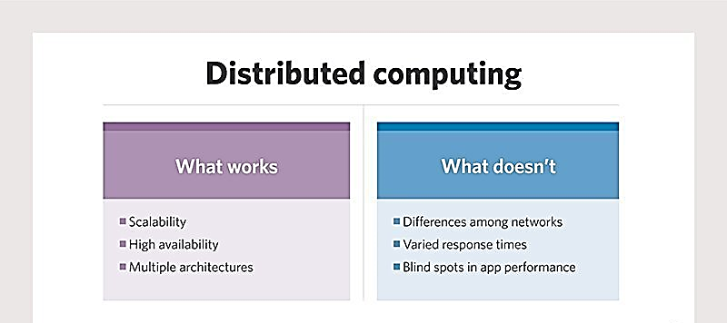

Slide 7
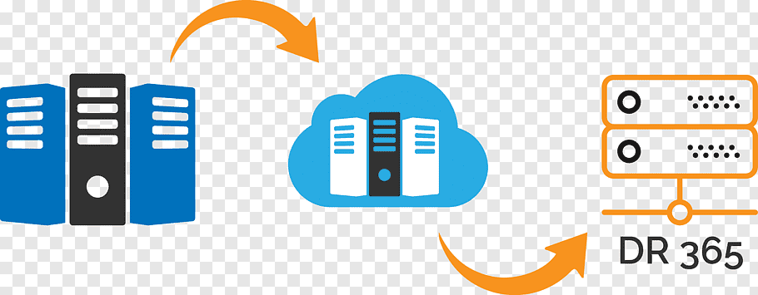
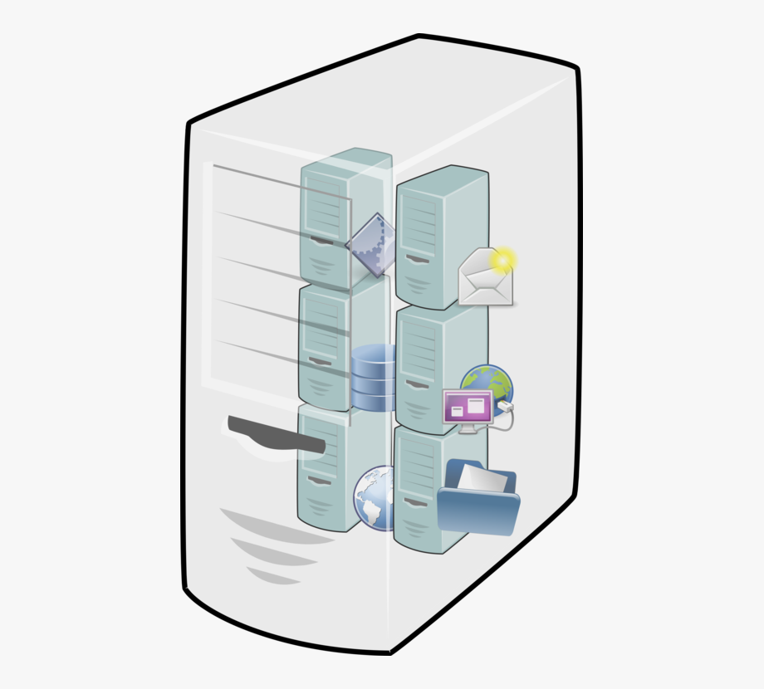
massively parallel processors (MPPs) VS Distributed computing
The most important factor in distributed computing is cost.
Large MPPs typically cost more than $10 million.
In contrast, users see very little cost in running their problems on a local set of existing computers
It is uncommon for distributed-computing users to realize the raw computational power of a large MPP, but they are able to solve problems several times larger than they could use one of their local computers.

Slide 8
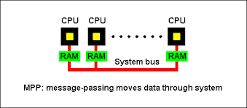
parallel processing
Common between distributed computing and MPP is the notion of message passing.
The message-passing model has become the paradigm of choice, from the perspective of the number and variety of multiprocessors that support it, as well as in terms of applications, languages, and software systems that use it.

Slide 9
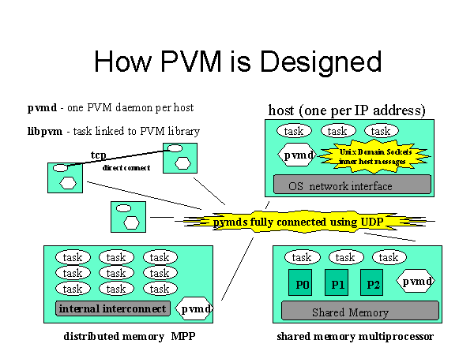
Parallel Virtual Machine
Parallel Virtual Machine (PVM) system uses the message passing model to allow programmers to exploit distributed computing across a wide variety of computer types, including MPPs.
A key concept in PVM is that it makes a collection of computers appear as one large virtual machine.

Slide 10
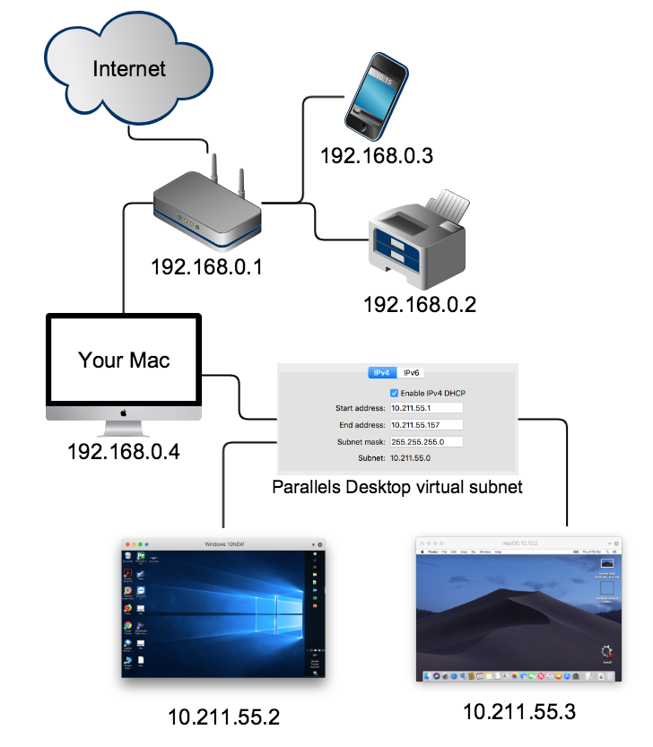
Parallel Virtual Machine
PVM -Is a software package that allows a heterogeneous collection of workstations (host pool) to function as a single high performance parallel machine (virtual)
PVM, through its virtual machine provides a simple yet useful distributed operating system
It has daemon running on all computers making up the virtual machine

Slide 11
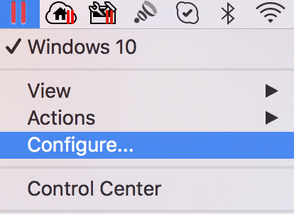
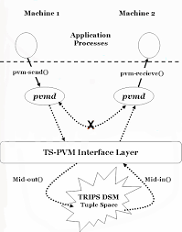
Parallel Virtual Machine
PVM Daemon (pvmd) The pvmd serves as a message router and controller
One pvmd runs on each host of a virtual machine The first pvmd (started by hand) is designated the master, while the others (started by the master) are called slaves
Only the master can start new slaves and add them to configuration or delete slave hosts from the machine

Slide 12
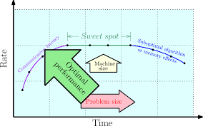
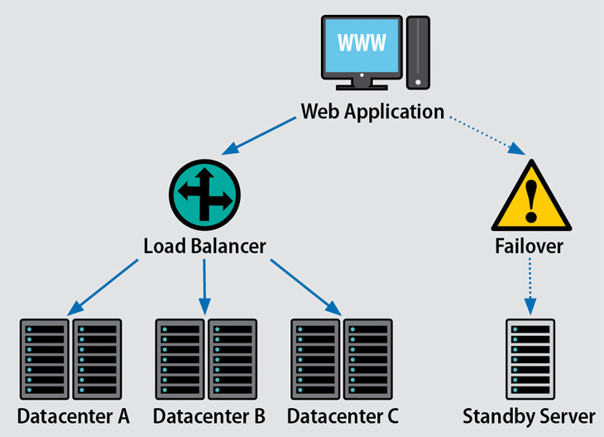
Parallel Virtual Machine
Resource Control
PVM is inherently dynamic in nature, and it has a rich set of resource control functions.
Hosts can be added or deleted
load balancing
task migration
fault tolerance
efficiency
MPI is specifically designed to be static in nature to improve performance

Slide 13

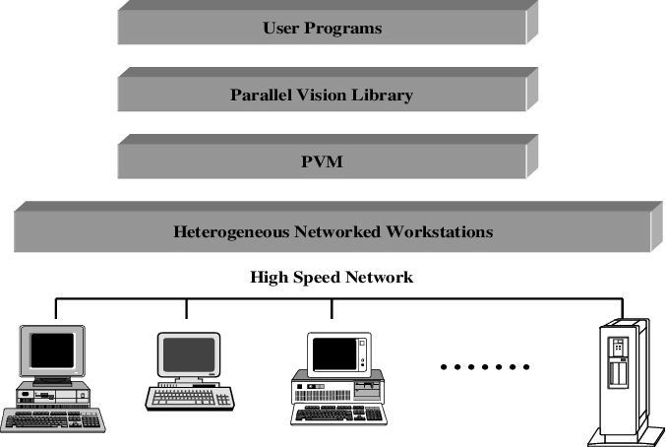
Heterogeneous Network Computing
In an MPP, every processor is exactly like every other in capability, resources, software, and communication speed.
Indeed, when a programmer wishes to exploit a collection of networked computers, he may have to contend with several different types of heterogeneity:
" Architecture
" Data format
" Computational speed

Slide 14
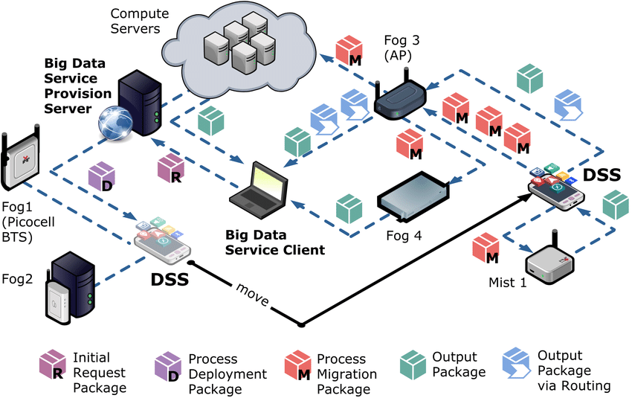
Distributed processing in heterogeneous fog computing environment.>>>

Slide 15
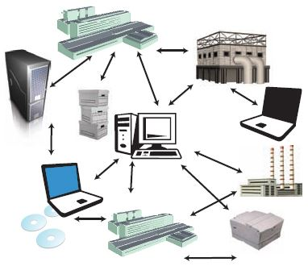

Advantages of Distributed computing
" By using existing hardware, the cost of this computing can be very low.
" Performance can be optimized by assigning each individual task to the most appropriate architecture.

Slide 16
Advantages of Distributed computing
" The virtual computer resources can grow in stages and take advantage of the latest computational and network technologies.
Programmers can use editors, compilers, and debuggers that are available on individual machines.

Slide 17

There are many Feature or factors translate into reduced development and debugging time, reduced contention for resources, reduced costs, and possibly more effective implementations of an application.
It is these benefits that Parallel Virtual Machine seeks to exploit. From the beginning, the Parallel Virtual Machine software package was designed to make programming for a heterogeneous collection of machines straightforward

Slide 18


https://books.google.com.sa/books?id=afjci8AOy6EC&pg=PA3&lpg=PA3&dq=It+is+these+benefits+that+Parallel+Virtual+Machine++seeks+to+exploit.+From+the+beginning,+the+Parallel+Virtual+Machine++software+package+was+designed+to+make+programming+for+a+heterogeneous+collection+of+machines+straightforward&source=bl&ots=9L96l5x6wQ&sig=ACfU3U2b-8WYkrNA2iCefI-utOkqOoizVg&hl=ar&sa=X&ved=2ahUKEwinqJK1k8zoAhWKHhQKHZc-DTQQ6AEwAHoECAwQLA
https://books.google.com.sa/books?id=4RDzX5mOKnwC&pg=PA442&lpg=PA442&dq=It+is+these+benefits+that+Parallel+Virtual+Machine++seeks+to+exploit.+From+the+beginning,+the+Parallel+Virtual+Machine++software+package+was+designed+to+make+programming+for+a+heterogeneous+collection+of+machines+straightforward&source=bl&ots=mxQOK-TDyg&sig=ACfU3U2vqbWwOg1wYrFr7kdXVa9izPThbw&hl=ar&sa=X&ved=2ahUKEwinqJK1k8zoAhWKHhQKHZc-DTQQ6AEwAXoECAwQNg
https://slideplayer.com/slide/10976915/
https://www.seminarsonly.com/computer%20science/Parallel%20Virtual%20Machine.php

Slide 19
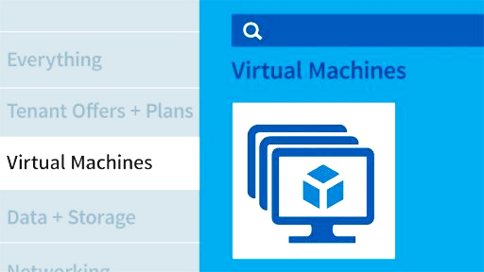
Thank YOU ☺

